Slide 1


Slide 2
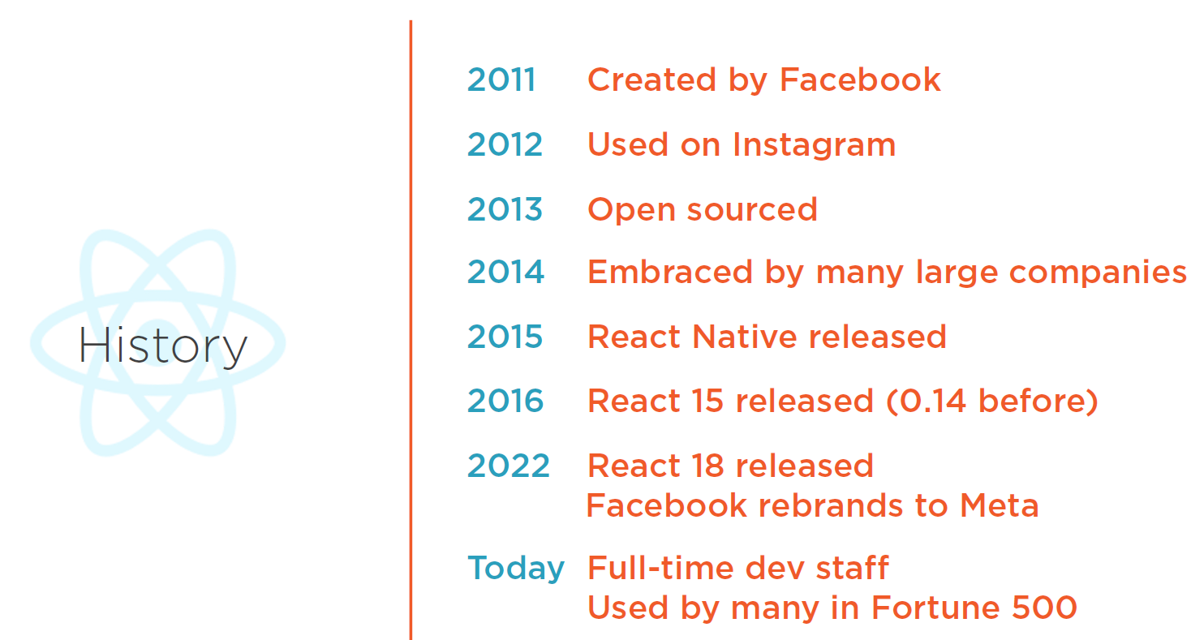

Slide 3
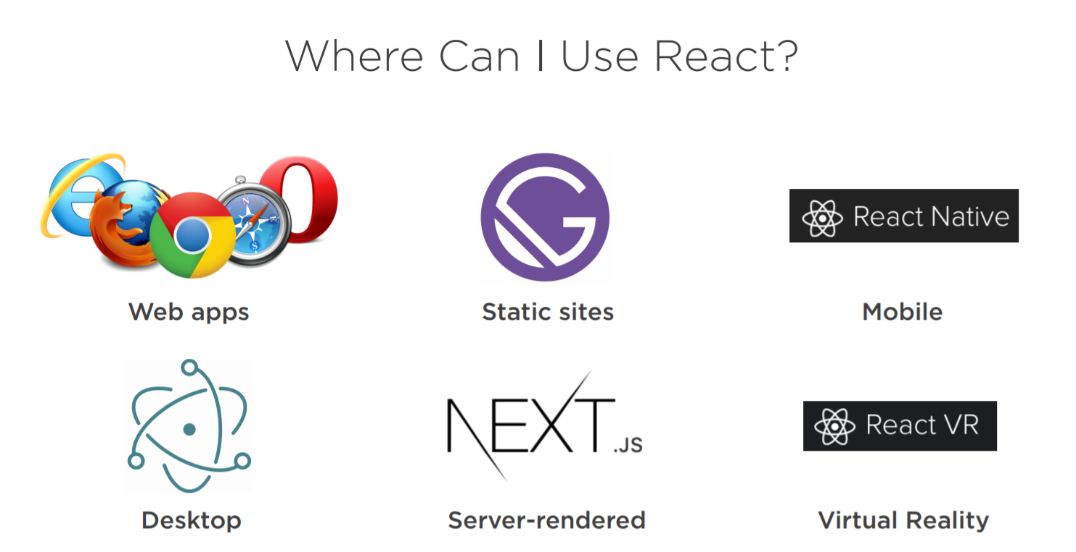

Slide 4
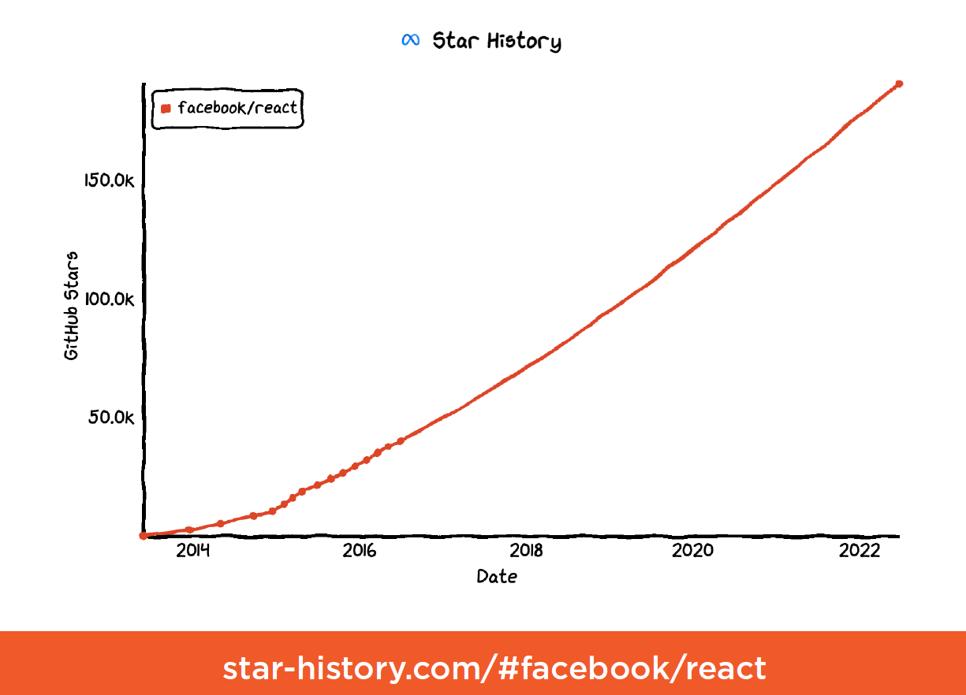
https://github.com/enaqx/awesome-react

Slide 5
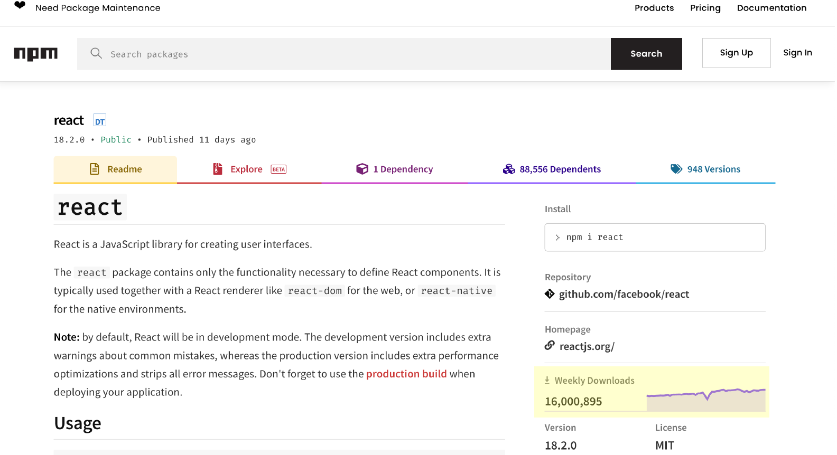

Slide 6


Slide 7


Slide 8
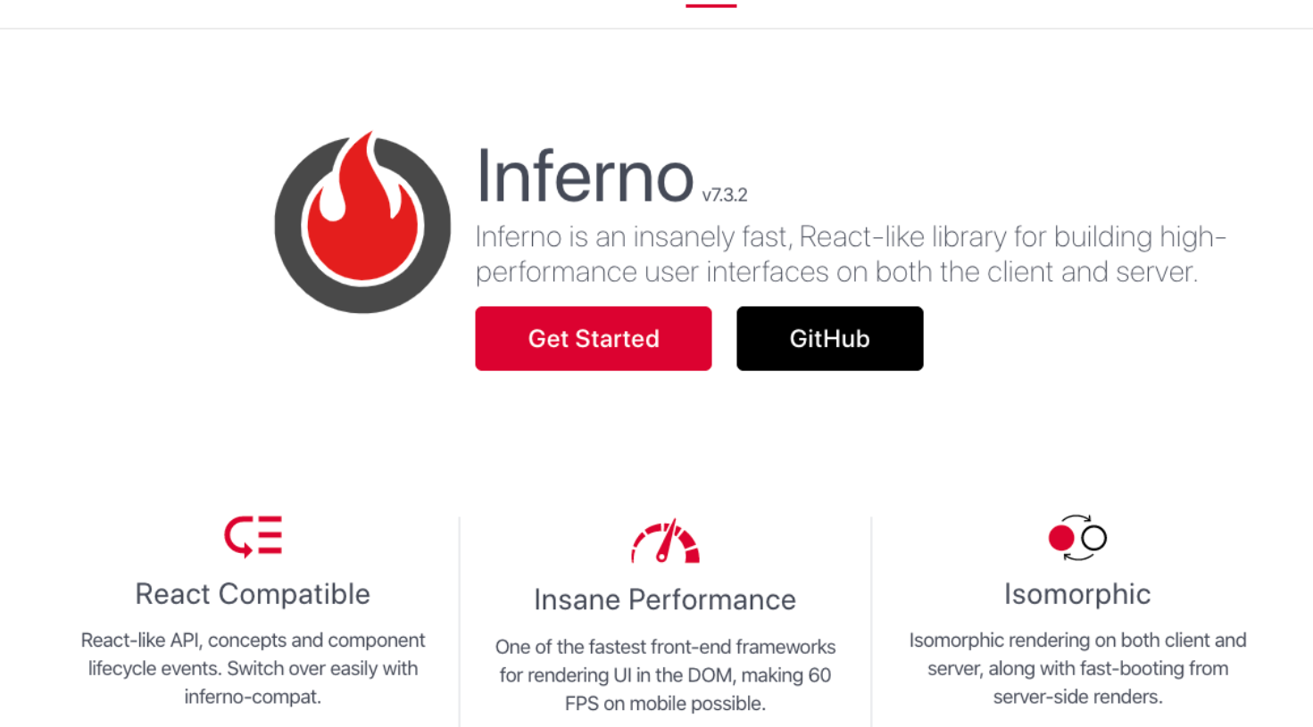

Slide 9


Slide 10
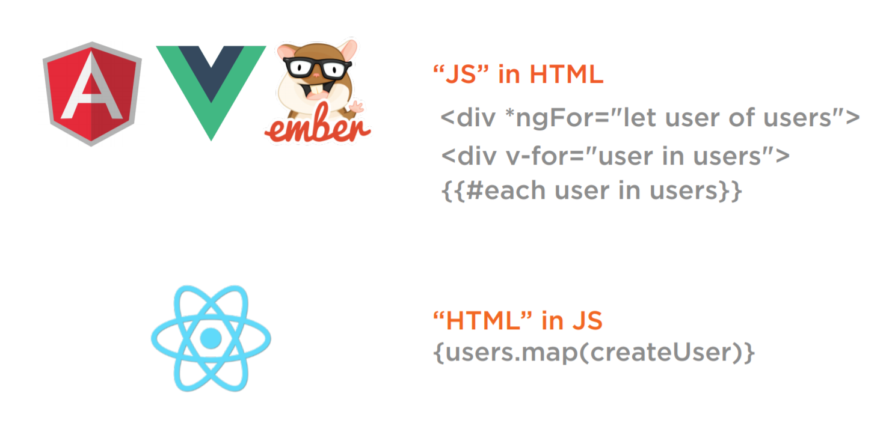

Slide 11
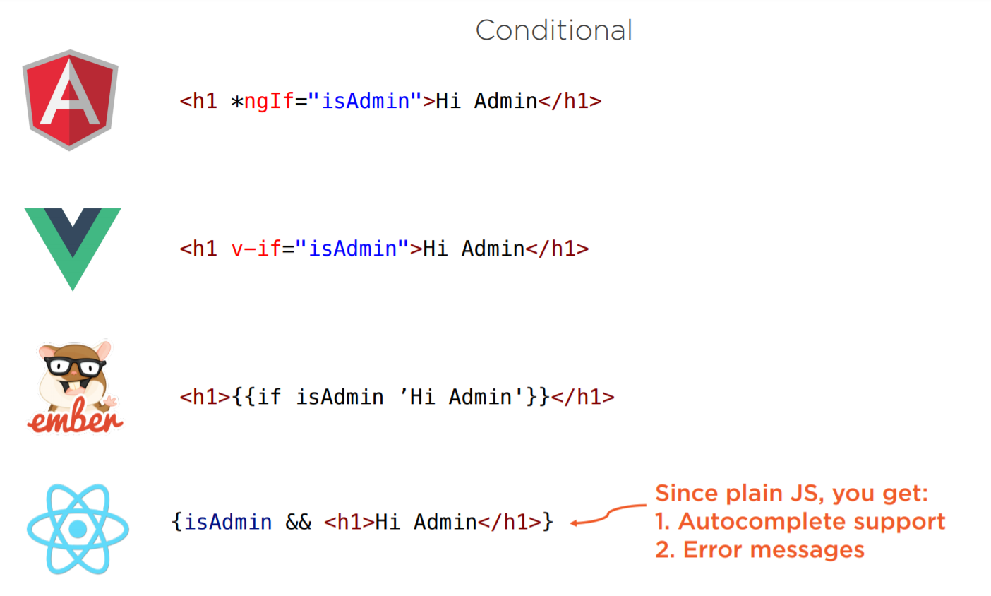

Slide 12
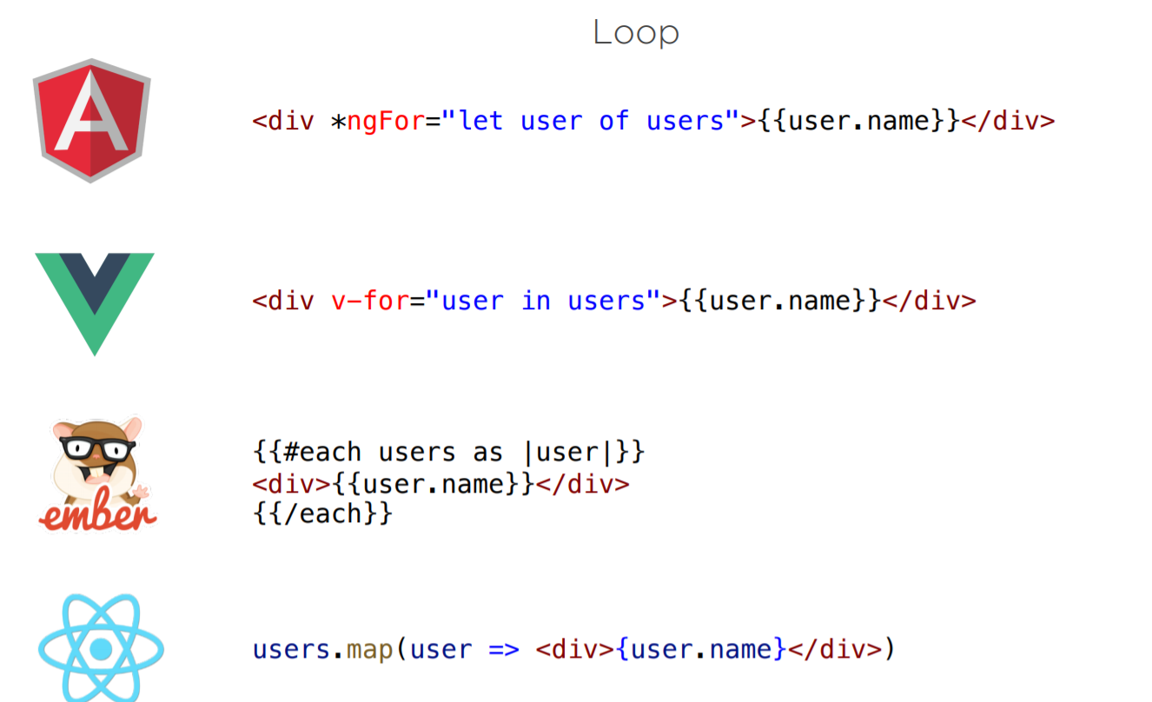

Slide 13
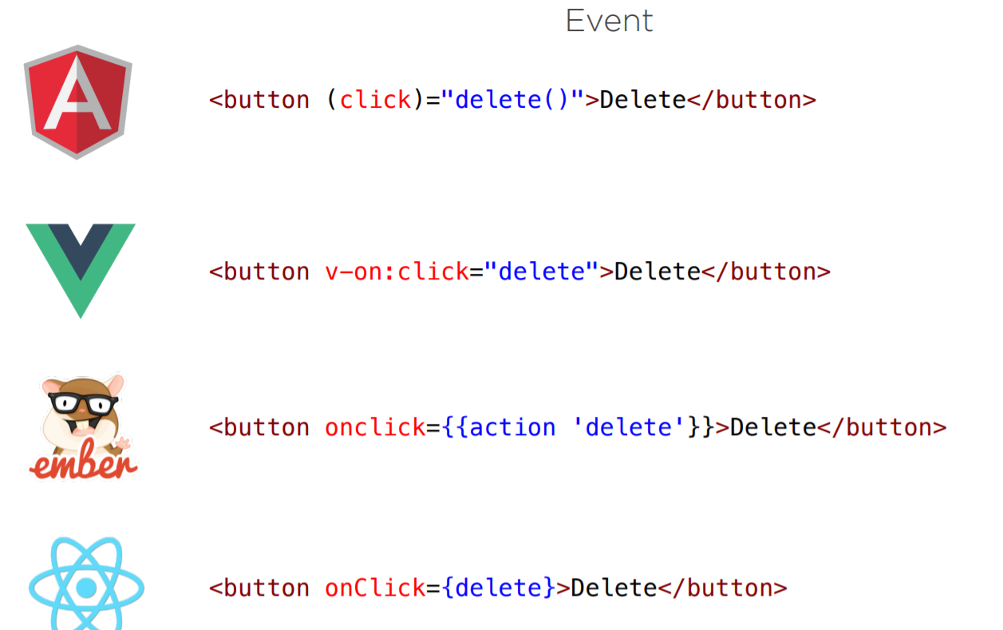

Slide 14
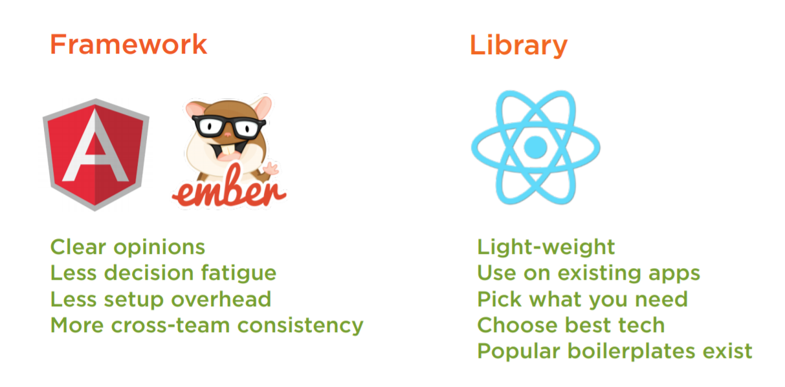

Slide 15
DEMO

Slide 16

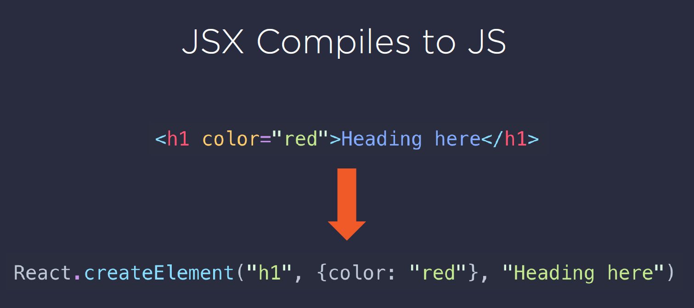
github.com/chentsulin/awesome-react-renderer

Slide 17
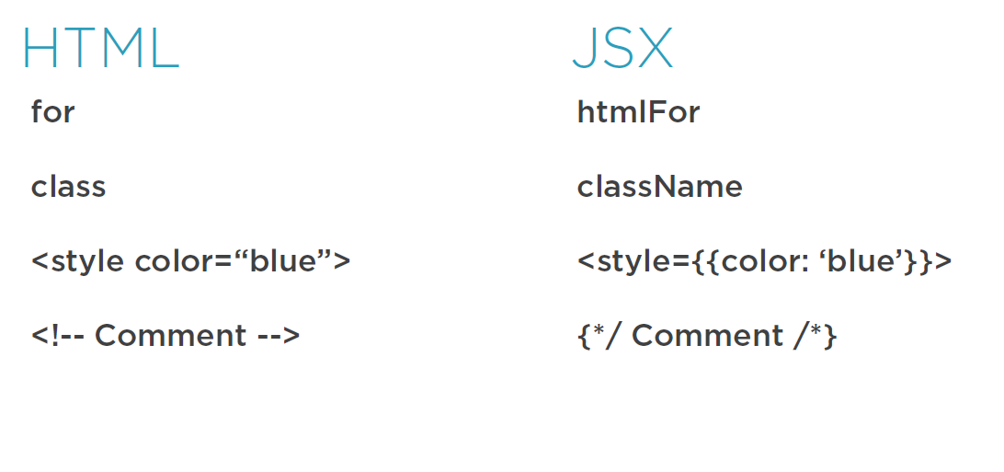

Slide 18
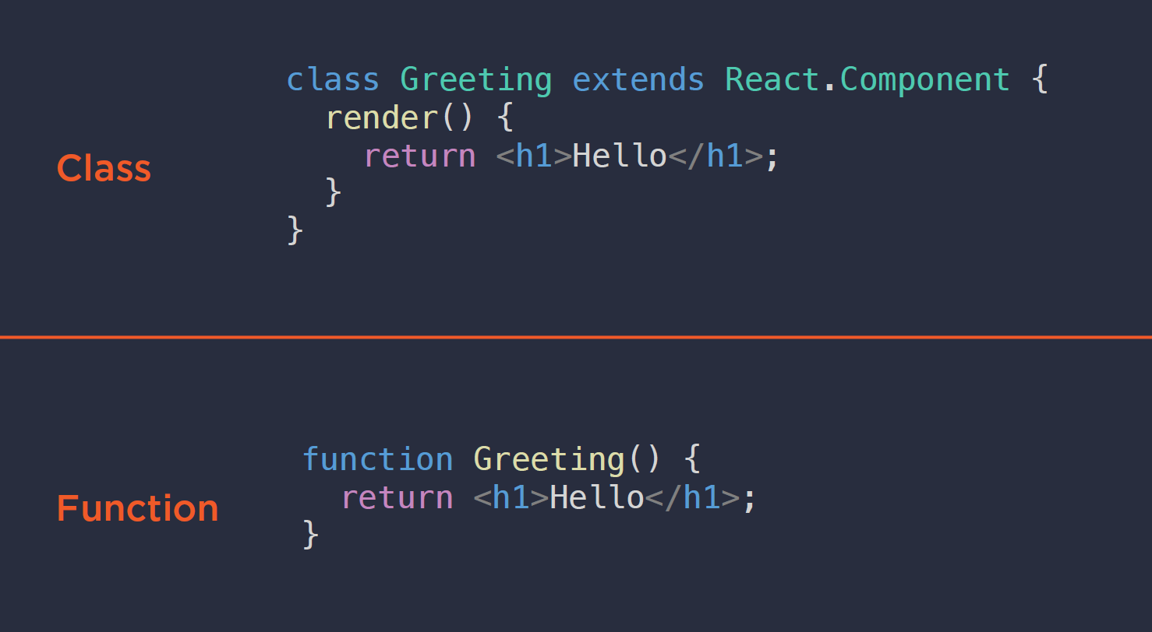

Slide 19
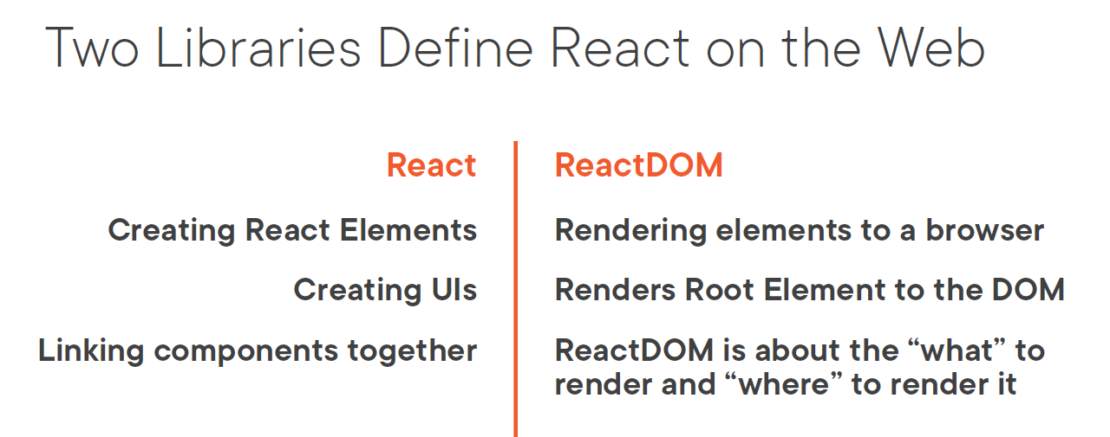

Slide 20
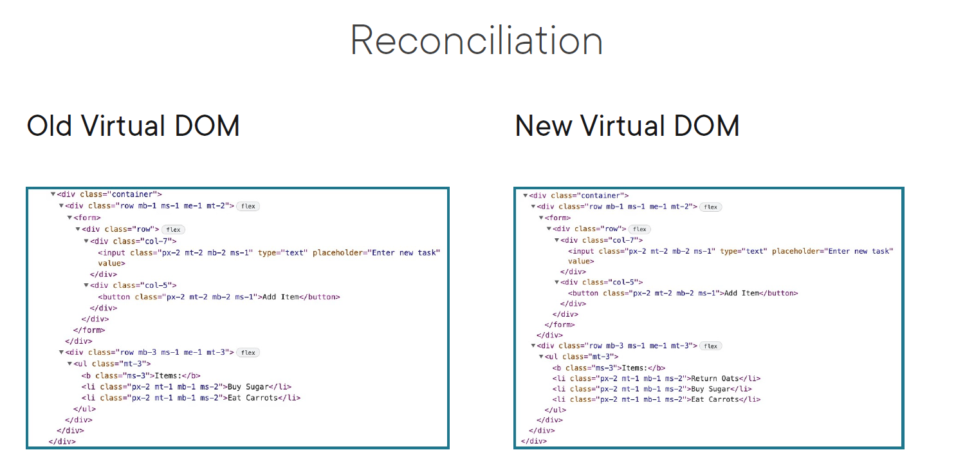

Slide 21
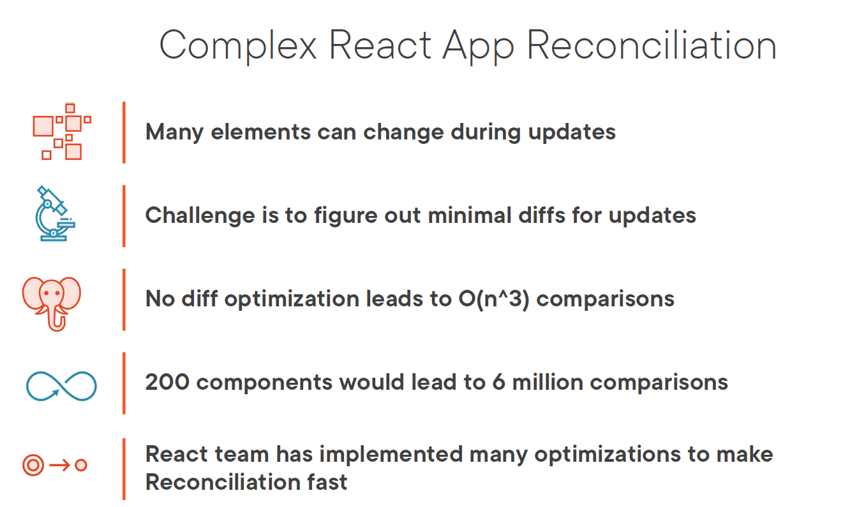

Slide 22
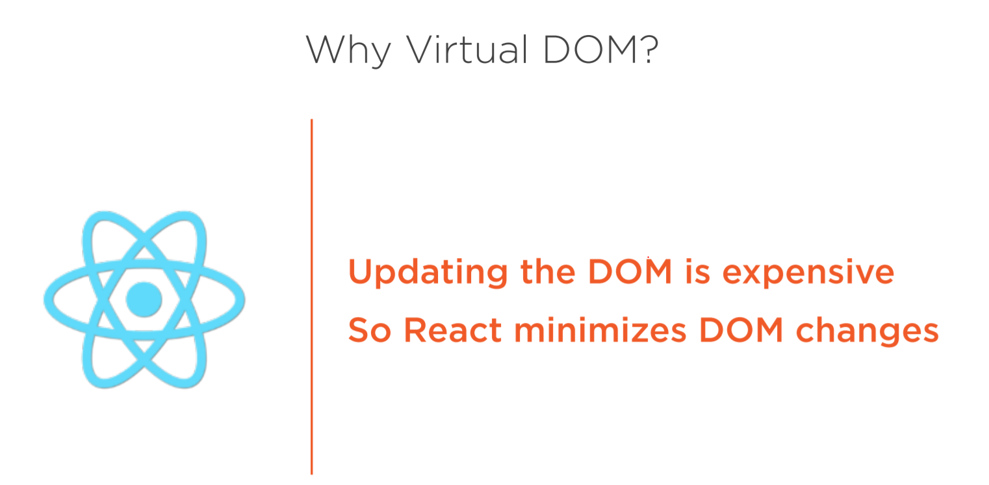
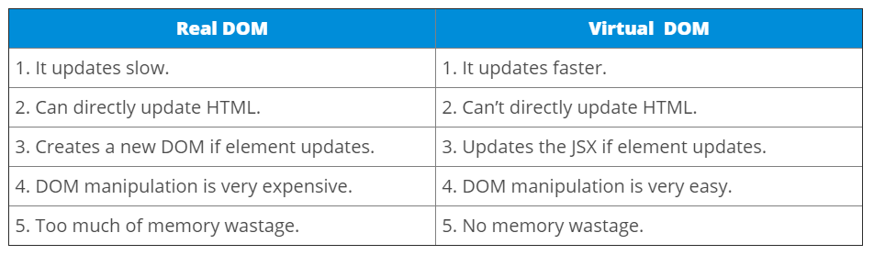

Slide 23
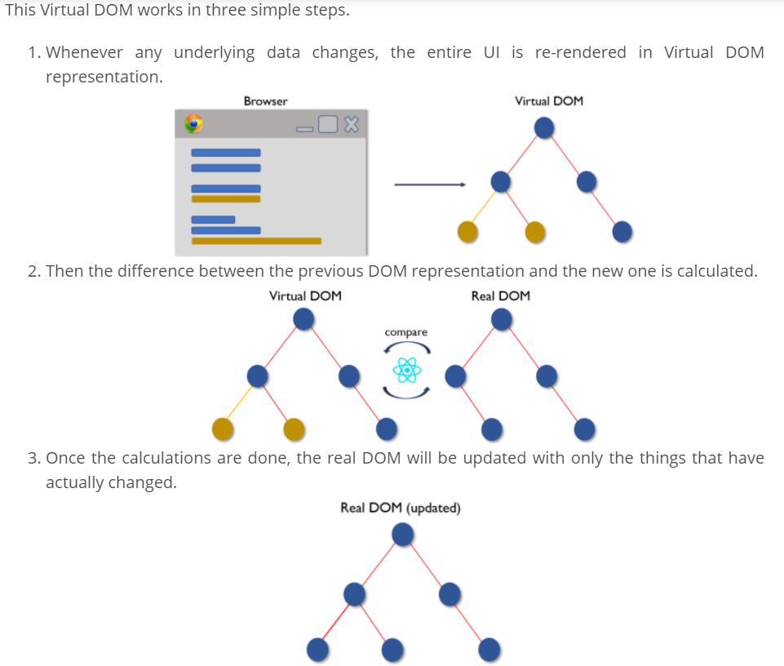

Slide 24
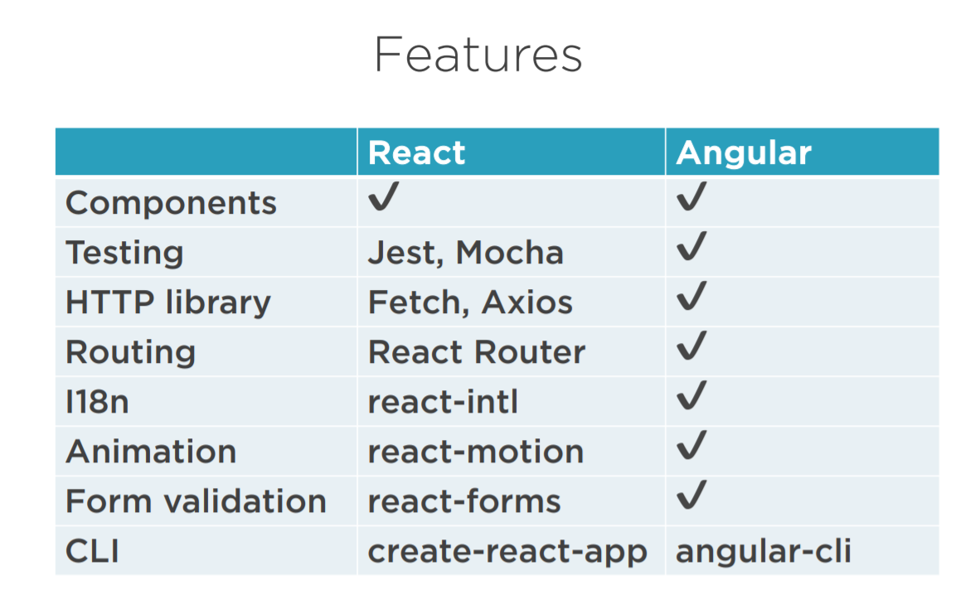

Slide 25
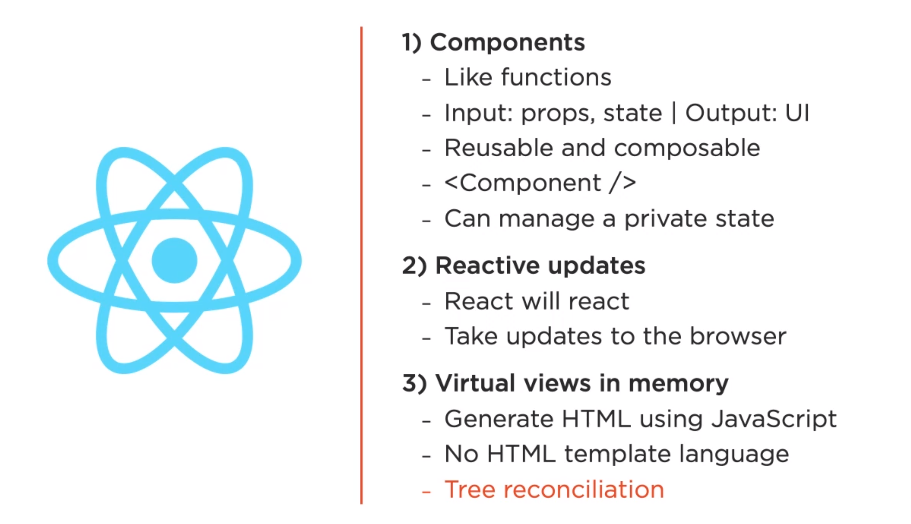
https://bg.reactjs.org/

Slide 26
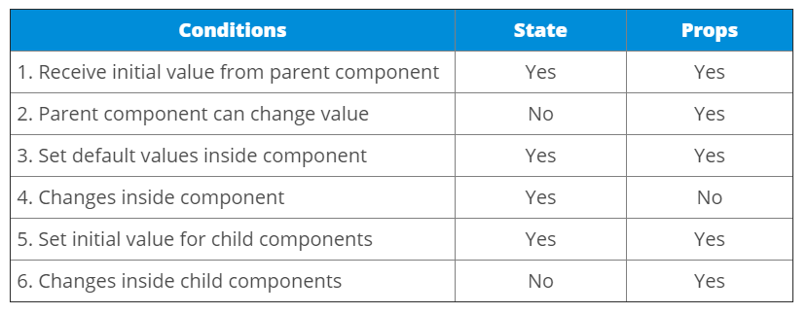
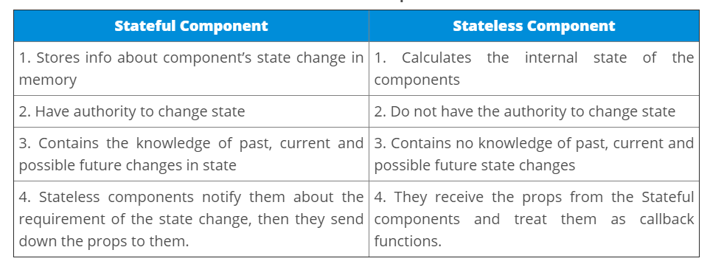

Slide 27
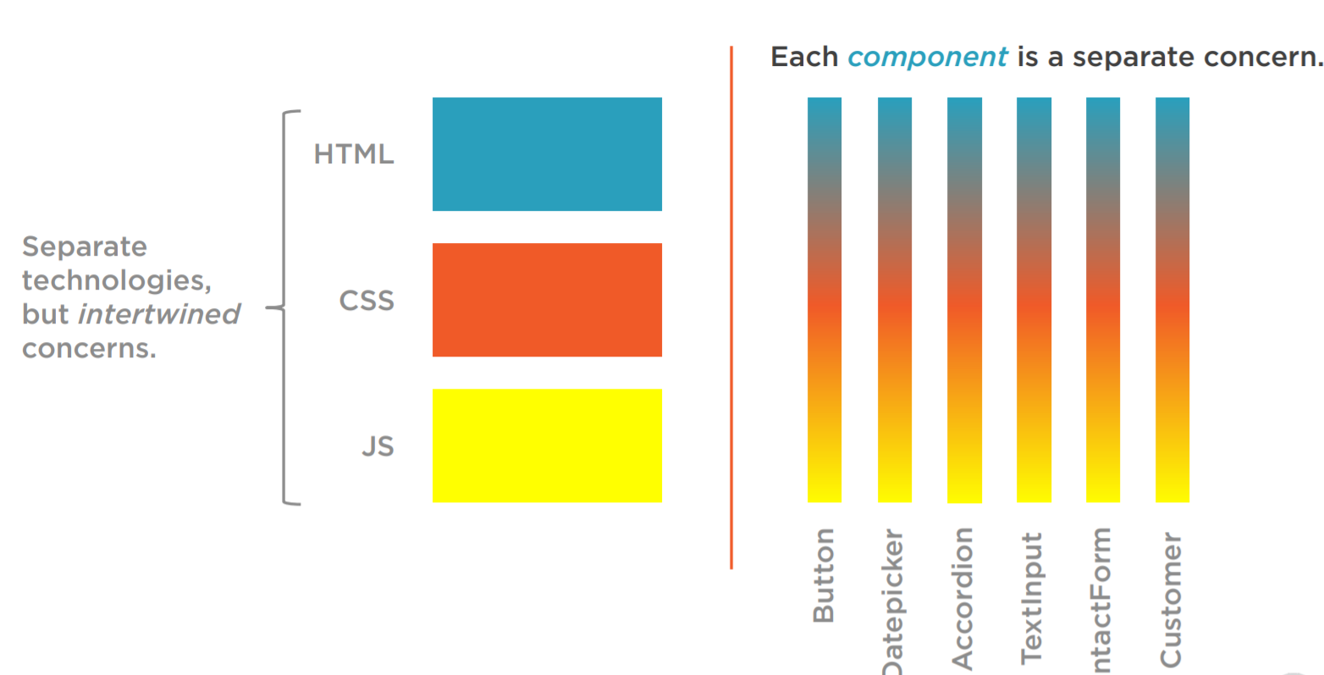
50,000

Slide 28
Playground
https://jscomplete.com/playground/scopes
https://jscomplete.com/playground/arrow-vs-regular-functions
https://jscomplete.com/playground/object-literals
https://jscomplete.com/playground/destructuring
https://jscomplete.com/playground/template-strings
https://jscomplete.com/playground/classes
https://jscomplete.com/playground/promises
https://jscomplete.com/playground/rgs1.1
https://jscomplete.com/playground/rgs1.2
https://jscomplete.com/playground/rgs1.4
https://jscomplete.com/playground/rgs1.3
https://jscomplete.com/playground/rgs1.5
https://jscomplete.com/playground/rgs1.6
https://jscomplete.com/playground/rgs1.8

Slide 29

codesandbox.io

